Slide 1
Multiple Linear Regression Analysis
mtcars
© Achmad Nafila Rozie

Slide 2
Outline
Background and Objective
Dataset
Analysis Framework
Findings
Conclusion

Slide 3
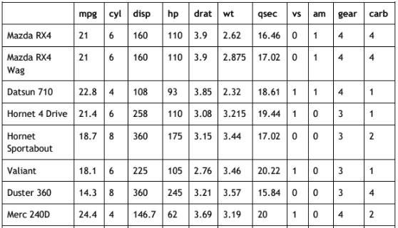
Dataset
Given 10 variables to be checked further into their impact into the mpg variables
Sample of the dataset

Slide 4
Analysis Framework
Import Dataset
Feature Selection
Data Preparation
Model Deployment
Correlation Check
Model Interpretation
Conclusion and Recommendation

Slide 5
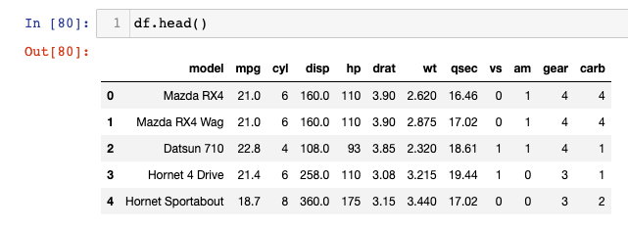
Findings - Import Dataset

Slide 6
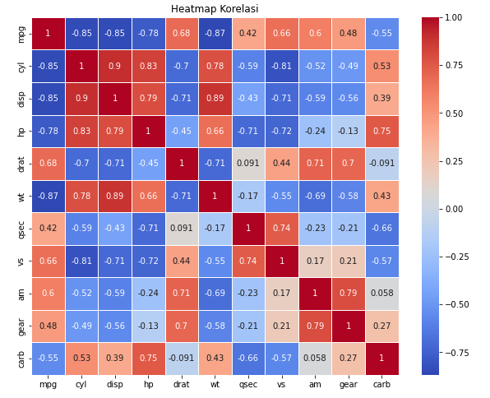
We found lot of inter X (independent) is highly correlated
We will exclude certain independent variables that are highly correlated with one another to mitigate the risk of multicollinearity in the analysis

Slide 7
Model Deployment and Interpretation

Slide 8
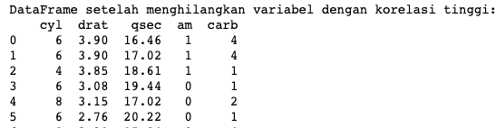
New Dataset after we eliminate 5 variables with correlation threshold = 0.7
We found that there are 5 variables that has low correlation (correlation inter-X variables) <= 0.7

Slide 9
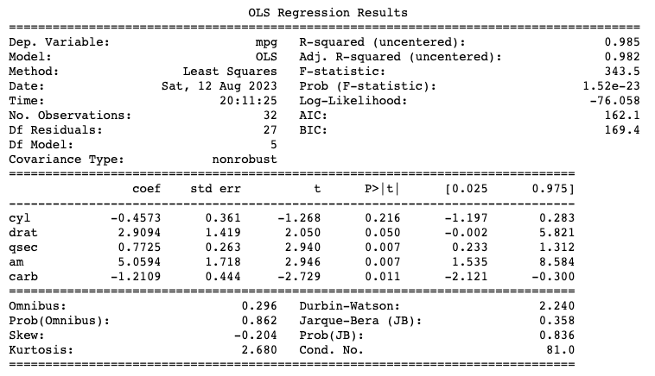
We generate quite “good” identifier with R-Squared 0.985, but 1 variable is not significant toward dependant variable
Interpretation
R-squared = 0.985 means 98.5% of variance in the model is able to be explained by these 5 variables.
Coefficient Overall We found that there is 1 column (cyl) that considered not significant - p-value >= 0.05 so we will iterate the model later.
Coefficient Interpretation Each coef show impact value between X (independent) variable into Y (dependent) variable . e.g. if the car is automatic (am) → means the car has higher mpg for 5.0594

Slide 10
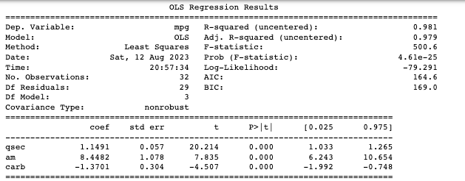

New Regression Results after ‘cyl’ column is eliminated
Interpretation
R-squared = 0.981 means 98.1% of variance in the model is able to be explained by these 5 variables.
Coefficient Overall All of the correlation was significantly impact toward the Y variable
Coefficient Interpretation
'qsec': A coefficient of 1.15 with a p-value of 0.000 indicates a positive effect on 'mpg' and is statistically significant.
'am' (automatic/manual transmission): A coefficient of 8.45 with a p-value of 0.000 indicates a significant positive effect on 'mpg.'
'carb' (carburetor): A coefficient of -1.37 with a p-value of 0.000 indicates a significant negative effect on 'mpg.'
Durbin-Watson: A Durbin-Watson value of 1.67 indicates that there is no significant autocorrelation within the model.

Slide 11
Conclusion and Recommendation
Conclusion
We could identify the mpg based on 3 independent variables: qsec, am, and carb.
The equation of the last multicollinear regression is as follow:
mpg = 1.15 * (qsec) + 8.85 * (am) - 1.37 * (carb) + e
am variable become the most significant variable into the increasing of mpg
Alternative Recommendation(s)
For users that likely to look more ‘economic’ which mean high mpg car - kindly to look for high qsec, automatic, and low number of carburetor.
Oppositely, kindly to look for low qsec, manual, and high number of carburetor

Slide 12
End

Slide 13



Feature Reduction to eliminate multicollinearity using VIF (Variance Inflation Factor)
1st FIV
2nd FIV
3rd FIV

